Slide 1
Data Mining Cup 2017 Revenue Forecast of Mail Order Pharmacy
2nd intermediate presentation
Data and Web Science Group
University of Mannheim
Alexander Brinkmann, Liane Gybas, Daniel Helfer, Nancy Kunath, Florian Schrage, Timo Sturm, Steffen Terheiden, Christoph Wagner
02.05.2017

Slide 2

Overview
Selection
Preprocessing
Transformation
Data Mining
Evaluation & Interpretation
Available data
…….
Target
Data
Preprocessed Data
Transformed Data
Patterns
Adopted from Fayyad et al. (1996)

Slide 3
DMC 17 - Challenge
Original task
Two step model
Adjusted two step model
Potential new model
Split data based on trend analysis
Predict the type of user action (Click/Basket =1 vs. Order =1)
Predict the type of user action (Click/Basket =1 vs. Order =1)
Predict the type of user action (Click/Basket =1 vs. Order =1)
Predict the revenue for every user action
Predict the quantity for all “order” actions
Predict the quantity/revenue for all “order” actions
Predict the revenue for all “order” actions
Evaluate result based on trend analysis
Regression problem
Classification problem
Trend analysis

Slide 4
Preprocessing
Feature Understanding
Feature Engineering
Selection
Preprocessing
Transformation
Data Mining
Evaluation & Interpretation
Available data
…….
Target
Data
Preprocessed Data
Transformed Data
Patterns
Adopted from Fayyad et al. (1996)

Slide 5
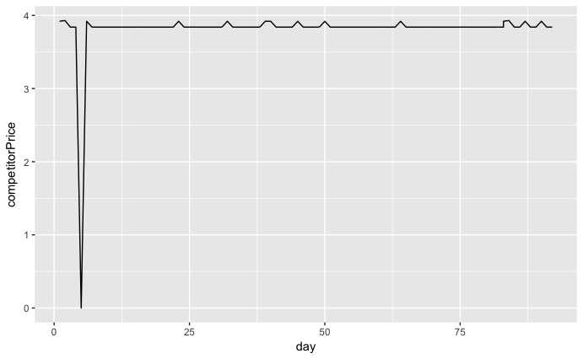
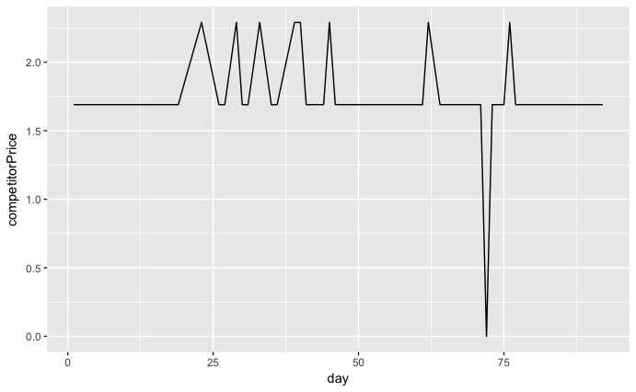
Feature Understanding and Engineering
CompetitorPrice
What does a CompetitorPrice of 0 mean?
976 entrys have a CompetitorPrice of 0
84 unique PIDs
These values are clear outliers
Strategies to handle these values
Remove the 0 values and handle them as missing values
Use the last or next given CompetitorPrice (whichever is the closest in time)
Use some average (mean or median) as a replacement
Notes:
Outlier – 0 too low

Slide 6
Feature Understanding and Engineering
Trend Analysis: New Features
alreadyBoughtOnSameDay: Was the product already sold on the same day?
alreadyBoughtQuantityOnSameDay: How often was the product sold on the same day?
dailyPriceDifference: Difference between the current price and the price on the day before
holidayIndicator: Weather the day is a public holiday
weekendIndicator: Weather the day is a weekend
productOrderRatio: To which percentage the product was ordered so far?
productOrderCounter: How often the product was ordered so far?
productActionCounter: How often was there any interaction with the product?
These Features might help to predict whether the product gets ordered in a better way by capturing some trend information

Slide 7
Data Mining and Evaluation
Trends
One Step Model
Two Step Model
Selection
Preprocessing
Transformation
Data Mining
Evaluation & Interpretation
Available data
…….
Target
Data
Preprocessed Data
Transformed Data
Patterns
Adopted from Fayyad et al. (1996)

Slide 8
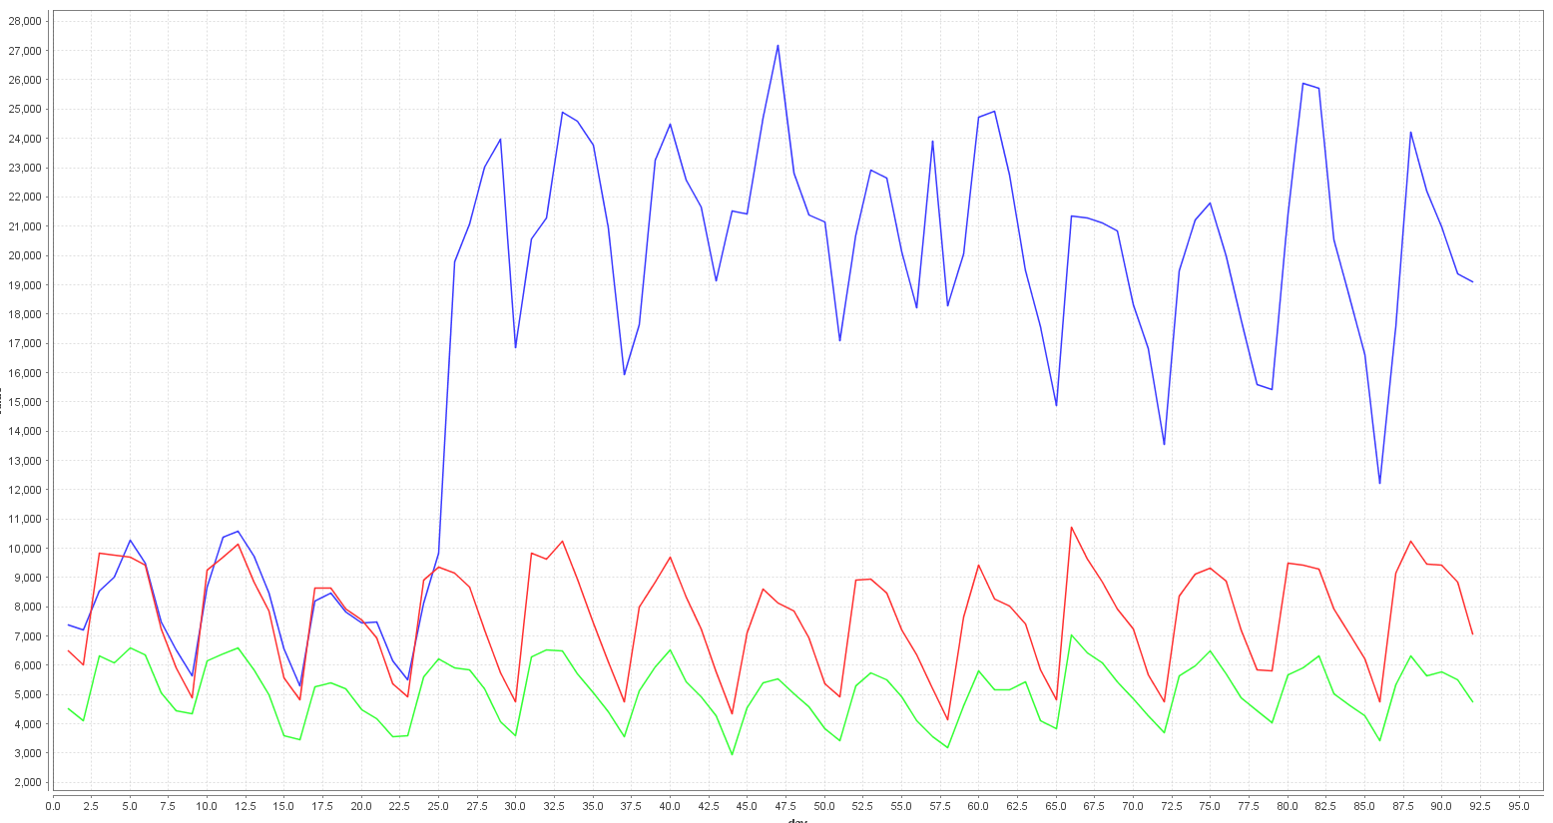
Trend – Click-Basket-Order
Click Order Basket

Slide 9
Trend – Click-Basket-Order
 | Judgment of the Court (First Chamber - EuGH) of 19 October 2016: Deutsche Parkinson Vereinigung eV vs Zentrale zur Bekämpfung unlauteren Wettbewerbs eV Setting of fixed prices for medicine, which are only available on prescription, is against European Law
Attribute | Till 19th | Starting from 20th
PriceRatioCompetitor | 0.152 to 3.232 | 0.003 to 53.497
PriceRatioRPP | 0.055 to 3.946 | 0.013 to 6.885
→ Prices are more volatile

Slide 10
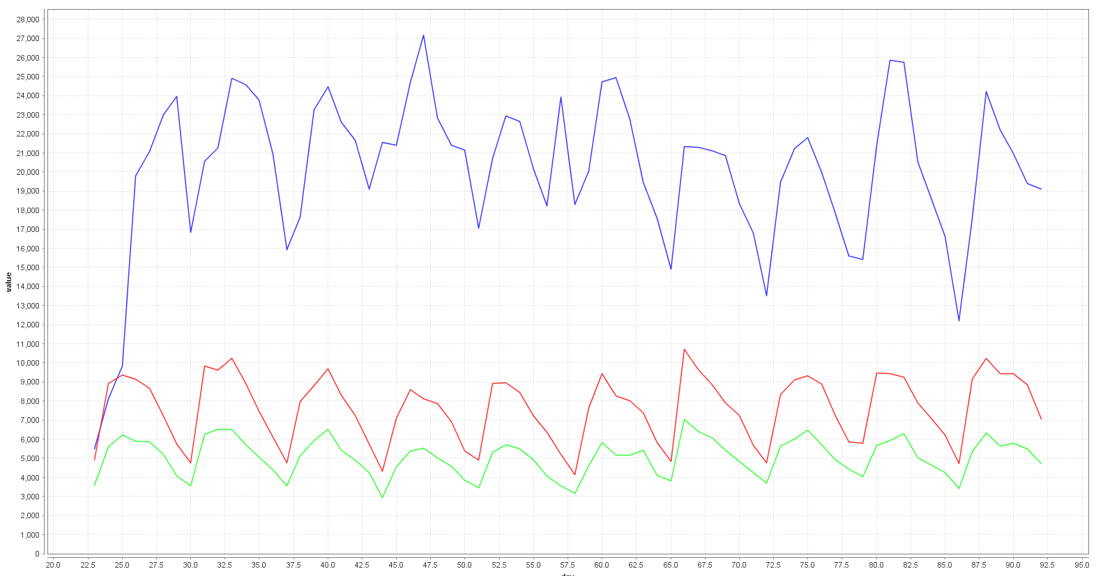
Trend – Click-Basket-Order
Click Order Basket
Notes:
23. Sonntag and starting point for Trend

Slide 11
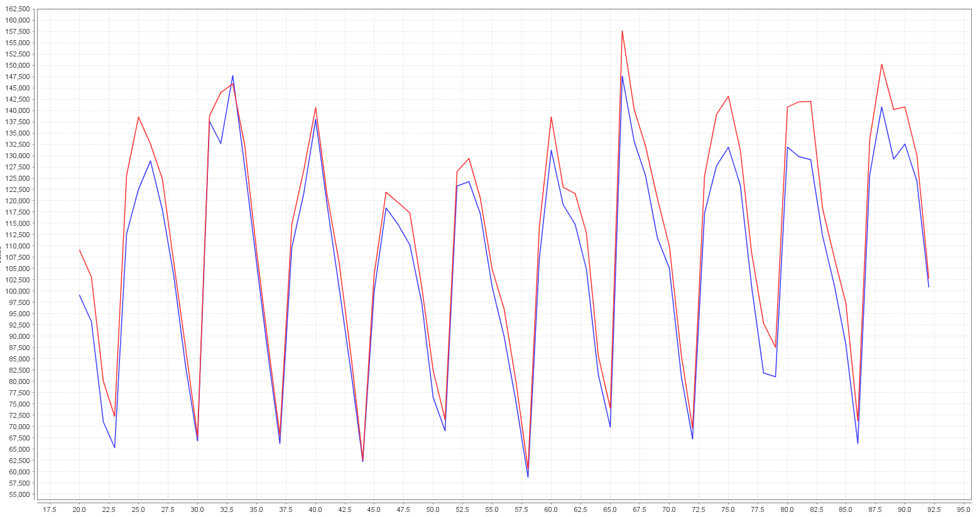
Trend – Ratio
AveragePrice x Order SumRevenue

Slide 12
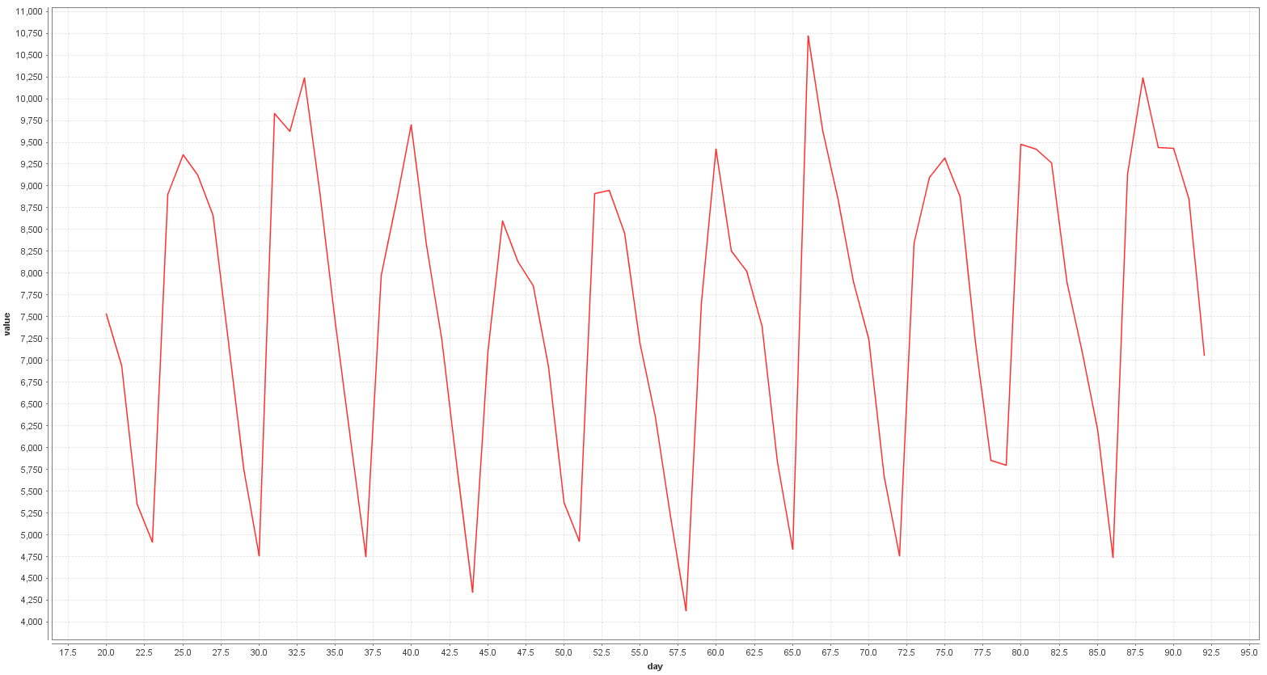
Trend – Ratio
Orders per day

Slide 13
Trend Applications
Usages of trend analysis
Data Split for Classification
Use as Feature
Adjust final Prediction

Slide 14
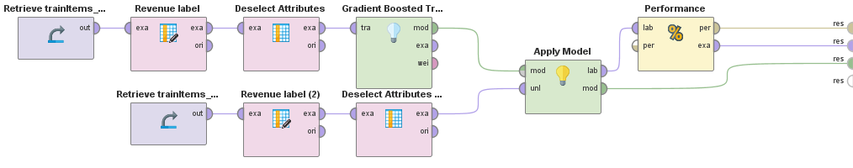
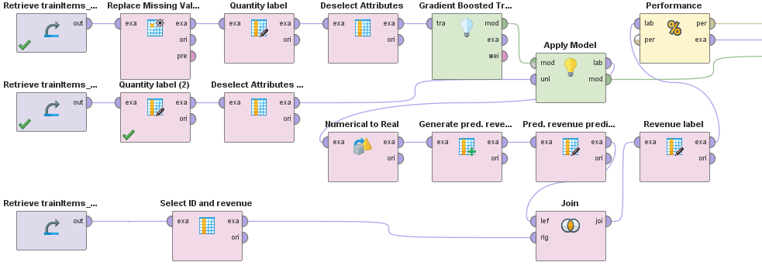
One Step Model
Performance of the One Step Model with revenue label
RMSE* = 9.702
Making the model comparable
Performance of the One Step Model with quantity label
RMSE* = 9.740
*RMSE : Root Mean Squared Error

Slide 15
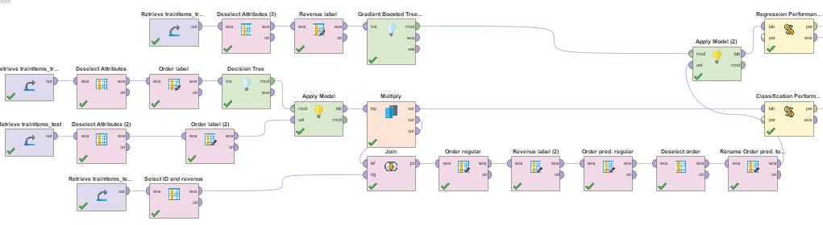
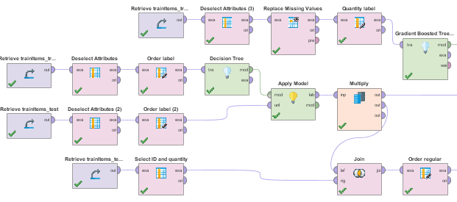
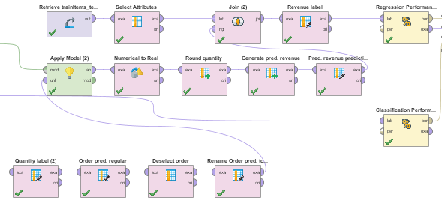
Two Step Model
Performance of the Two Step Model with revenue label
Accuracy = 75.86 % (Baseline)
RMSE = 10.870
Performance of the Two Step Model with quantity label
Accuracy = 75.86% (Baseline)
RMSE = 10.887

Slide 16
Two Step Model – Further thoughts
Currently, the two step model performs worse than the one step model.
The reason is the very poor classifier.
What if the classifier predicts the “order” action perfectly?
The two step model has the potential to reduce the RMSE to 4.797.
(by not changing the regression model)
Conclusion:
We want to further improve the classification and try to expand the model with a trend analysis.

Slide 17
Questions?
Feel free to ask!

